Slide 1


Transient loss of consciousness (‘blackouts’) management in adults and young people – ambulance service slide set
Implementing NICE guidance
August 2010
NICE clinical guideline 109
Notes:
ABOUT THIS PRESENTATION:
This presentation has been written to help you raise awareness of the NICE clinical guideline on Transient loss of consciousness (TLoC for short). This guideline has been written for healthcare professionals who work in any healthcare setting in which people who have experienced TLoC receive management. This includes GPs, ambulance staff, emergency department staff and specialists.
The guideline is available in a number of formats, including a quick reference guide which displays the guideline as an algorithm. You should hand out copies of the quick reference guide (algorithm) at your presentation so that your audience can refer to it. See the end of the presentation for ordering details.
You can add your own organisation’s logo alongside the NICE logo.
This slide set has been written specifically for the ambulance service in collaboration with Mark Whitbread and Joanne Smith of London Ambulance Service NHS Trust and reviewed by John Pawelec - Yorkshire Ambulance service. This presentation focuses on the recommendations which are applicable to the ambulance service. A podcast which complements this slide set is available from the NICE website. See slide 15 ‘find out more’ for details about accessing the podcast
Within all of the slides we have included notes for presenters, broken down into ‘key points to raise’, which you can highlight in your presentation, and ‘additional information’ that you may want to draw on, such as a rationale or an explanation of the evidence for a recommendation.
‘Recommendation not in full’ is written next to some of the recommendations in the notes pages. This means that the citation of the recommendation only includes the part of the recommendation relevant to the ambulance service. For the full recommendation see the NICE guideline
DISCLAIMER
This slide set is an implementation tool and should be used alongside the published guidance. This information does not supersede or replace the guidance itself.
PROMOTING EQUALITY
Implementation of this guidance is the responsibility of local commissioners and/or providers. Commissioners and providers are reminded that it is their responsibility to implement the guidance, in their local context, in light of their duties to avoid unlawful discrimination and to have regard to promoting equality of opportunity. Nothing in this guidance should be interpreted in a way which would be inconsistent with compliance with those duties.

Slide 2


Introduction
New NICE guideline on ‘transient loss of consciousness’ (TLoC)
Has implications for ambulance services
Will look at importance of:
thorough assessment and history taking
ECG acquisition
identifying red flags
diagnosing uncomplicated faint and
situational syncope
identifying other potential causes of TLoC
directing people into the appropriate pathway
Notes:
NOTES FOR PRESENTERS:
Key points to raise:
NICE have recently produced a guideline on TRANSIENT LOSS OF CONSCIOUSNESS (TLoC). This has important implications for PRE-HOSPITAL CARE and how ambulance services will manage people who present with suspected TLoC.
This presentation aims to ensure that the relevant recommendations from this document are made available to ambulance services in a digestible format.
The ambulance service are often present during or just after a patient has experienced TLoC. They are responsible for ensuring the patient is directed towards the appropriate pathway to make sure the person receives the correct diagnosis quickly and efficiently leading to a suitable management plan.
Throughout this presentation additional information sections have been added to the notes. These are not NICE guidance but have been included to help in the application of the recommendations to practice. This additional information has been sourced from senior clinicians at London Ambulance Service.

Slide 3
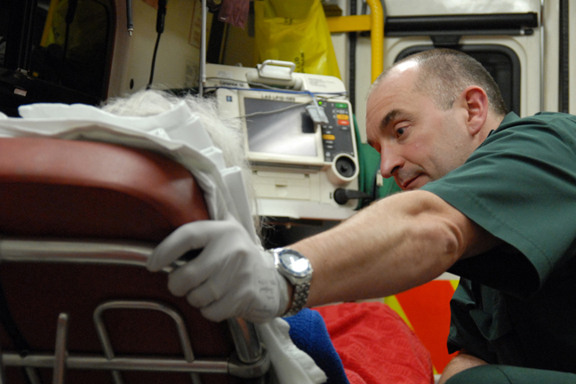
Background: TLoC
Definition: TLoC is a spontaneous loss of consciousness with complete recovery
TLoC is very common. Causes are neurological, psychological or cardiovascular (most common)
Diagnosis is often inaccurate (substantial proportion of those initially diagnosed and treated for epilepsy have a cardiovascular cause for TLoC!)
Notes:
NOTES FOR PRESENTERS:
Key points to raise:
TLoC may be defined as spontaneous loss of consciousness with complete recovery. In this context, complete recovery would involve full recovery of consciousness without any residual neurological deficit. An episode of TLoC is often described as a ‘blackout’ or a ‘collapse’, but some people collapse without TLoC and this guideline does not cover that situation.
Transient loss of consciousness (TLoC) is very common: it affects up to half the population in the UK at some point in their lives.
There are various causes of TLoC, including cardiovascular disorders (which are the most common), neurological conditions such as epilepsy, and psychogenic attacks.
The diagnosis of the underlying cause of TLoC is often inaccurate – be aware! Just because a patient has been told they are ‘epileptic’ it doesn’t necessarily mean they are. They may have never even had an ECG taken before!
People experiencing TLoC may come under the care of a range of clinicians, and the lack of a clear pathway may contribute to misdiagnosis and inappropriate treatment.
People experiencing TLoC are often discharged without any clear diagnosis. This is particularly devastating when a young person experiences several TLoCs throughout their life and it is not until they suffer a cardiac arrest from an undiagnosed hereditary heart condition such as ‘long QT syndrome’ that a diagnosis is finally made. Unfortunately this is often too late!

Slide 4
History! History! History!
It’s all in the history: interview witnesses as well as the person
Ask them to describe what happened and record details about:
Before event circumstances
posture
prodromal symptoms (for example, sweating or
feeling warm/hot)
During event appearance (for example, eyes open or shut) colour
movement (for example, limb jerking and duration)
tongue-biting (side or tip bitten?)
injury
duration of TLoC
During recovery confusion
weakness down one side
Notes:
NOTES FOR PRESENTERS:
Key points to raise:
History taking is a vital component of patient assessment regarding TLoC. If you are able to gather the info listed here, this will assist greatly in diagnosis when the patient is referred for expert assessment.
If the person with suspected transient loss of consciousness (TLoC) has sustained an injury or they have not made a full recovery of consciousness, use clinical judgement to determine appropriate management and the urgency of treatment. [1.1.1.1]
Ask the person who has had the suspected TLoC, and any witnesses, to describe what happened before, during and after the event. Try to contact by telephone witnesses who are not present. Record details about:
circumstances of the event
person’s posture immediately before loss of consciousness
prodromal symptoms (such as sweating or feeling warm/hot)
appearance (for example, whether eyes were open or shut) and colour of the person during the event
presence or absence of movement during the event (for example, limb-jerking and its duration)
any tongue-biting (record whether the side or the tip of the tongue was bitten)
injury occurring during the event (record site and severity)
duration of the event (onset to regaining consciousness)
presence or absence of confusion during the recovery period
weakness down one side during the recovery period. [1.1.1.2]
If TLoC is secondary to a condition that requires immediate action, use clinical judgement to determine appropriate management and the urgency of treatment. [1.1.4.1]

Slide 5
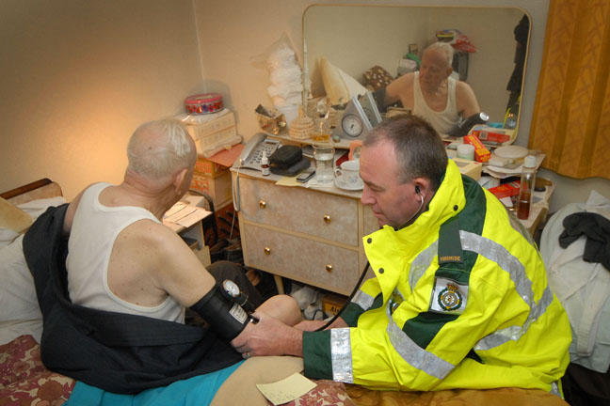
Does the history confirm TLoC?
No
Instigate appropriate management, for
example, for simple fall (mechanical) or
‘assist only’ (without loss of consciousness)
Uncertain or Yes
Assess and record details of previous TLoC, medical history, family history, vital signs and other cardiovascular/neurological signs
Record a 12-lead ECG for everyone with TLoC
If during the initial assessment there is suspicion of an underlying problem causing TLoC or in addition to TLoC, carry out relevant examination (for example, if diabetic hypoglycaemia is suspected, check blood glucose)
If TLoC is secondary to a condition that requires immediate action, use clinical judgement to determine appropriate management and the urgency of treatment
Notes:
NOTES FOR PRESENTERS:
Key points to raise:
Use information gathered from all accounts of the suspected TLoC (see recommendation 1.1.1.2) to confirm whether or not TLoC has occurred. If this is uncertain it should be assumed that they had TLoC until proven otherwise. But, if the person did not have TLoC, instigate suitable management (for example, if the person is determined to have had a fall, rather than TLoC, refer to ‘Falls: the assessment and prevention of falls in older people’ [NICE clinical guideline 21]). [1.1.1.4]
If following the account TLoC is confirmed or remains uncertain...
Assess and record:
details of any previous TLoC, including number and frequency
the person’s medical history and any family history of cardiac disease (for example, personal history of heart disease and family history of sudden cardiac death)
current medication that may have contributed to TLoC (for example, diuretics)
vital signs (for example, pulse rate, respiratory rate and temperature) – repeat if clinically indicated
lying (supine) and standing blood pressure if clinically appropriate
other cardiovascular and neurological signs. [1.1.2.1]
12-lead ECG (see slide 6 or 7 and recommendations 1.2.2.2. and 1.2.2.3 for further information)
Repeated vital signs should be completed on scene or en route to hospital
If during the initial assessment, there is suspicion of an underlying problem causing TLoC, or additional to TLoC, carry out relevant examinations and investigations (for example, check blood glucose levels if diabetic hypoglycaemia is suspected, or haemoglobin levels if anaemia or bleeding is suspected. [1.1.2.4] (recommendation not in full)
If TLoC is secondary to a condition that requires immediate action, use clinical judgement to determine appropriate management and the urgency of treatment. [1.1.4.1]

Slide 6

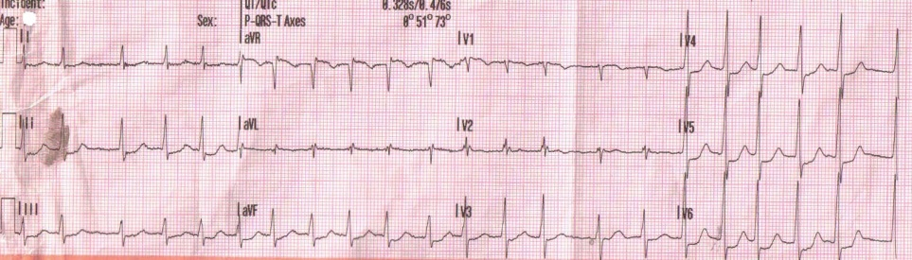
The 12-lead ECG with automated interpretation
Record a 12-lead ECG, preferably using automated interpretation
Treat the following as ‘red flags’ (a red flag indicates the need for referral for specialist assessment – convey to emergency department):
    conduction abnormality (for example, complete RBBB/LBBB or any degree of heart block)
    evidence of long or short QT interval or
    any ST segment or T wave abnormalities
Notes:
NOTES FOR PRESENTERS:
Recommendation 1.1.2.2 in full:
Record a 12-lead electrocardiogram (ECG) using automated interpretation. Treat as a red flag (see recommendation 1.1.4.2) if any of the following abnormalities are reported on the ECG printout:
conduction abnormality (for example, complete right or left bundle branch block or any degree of heart block)
evidence of a long or short QT interval, or
any ST segment or T wave abnormalities.
Additional ambulance service information
NOTE - This is not NICE guidance
If TLoC is uncertain or confirmed a 12-lead ECG should be recorded. A machine with automated interpretation is preferred as this will ‘flag up’ the more unusual abnormalities which some pre-hospital personnel may not be familiar with.
When NICE recommend referral to a specialist within 24 hours, this means that the ambulance service should convey the patient to the emergency department and the emergency department will make that referral.

Slide 7
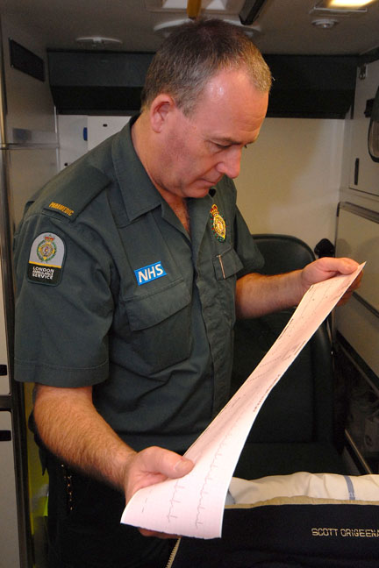

The manual 12-lead ECG
Manual 12-lead ECG reading should be reviewed by a healthcare professional trained and competent in identifying any of the following abnormalities, which are all “red flags”:
  inappropriate persistent bradycardia
  any ventricular arrhythmia
  (including ventricular ectopic beats)
  long QT (corrected QT> 450 ms) and short QT (corrected QT < 350 ms)
  Brugada syndrome
  ventricular pre-excitation
  (part of Wolff-Parkinson-White syndrome)
  left or right ventricular hypertrophy
  abnormal T wave inversion
  pathological Q waves
  atrial arrhythmia (sustained)
  paced rhythm
Notes:
NOTES FOR PRESENTERS:
Key points to raise:
If a 12-lead ECG with automated interpretation is not available, take a manual 12-lead ECG reading and have this reviewed by a healthcare professional trained and competent* in identifying the following abnormalities.
Inappropriate persistent bradycardia; any ventricular arrhythmia (including ventricular ectopic beats); long QT (corrected QT > 450 ms) and short QT (corrected QT < 350 ms) intervals; Brugada syndrome; ventricular pre-excitation (part of Wolff-Parkinson-White syndrome); left or right ventricular hypertrophy; abnormal T wave inversion; pathological Q waves; atrial arrhythmia (sustained); paced rhythm. [1.1.2.3]
Anyone with TLoC who has any of these ECG abnormalities should be referred urgently for specialist cardiovascular assessment by an appropriate specialist within 24 hours [1.1.4.2 modified]
Additional ambulance service information. This is not a specific NICE recommendation
* may be the attending paramedic/EMT if very competent in ECG interpretation, but for identification of the less common abnormalities the opinion of an experienced doctor/cardiologist/specialist nurse will be required.
Inappropriate bradycardia would be a bradycardia in someone who is not a very fit athlete, or a patient on medication such as beta blockers which slows the heart rate. Any ventricular arrhythmia – this can be ascertained in most cases by the width of the QRS complex. If >120 msecs or 3 small squares then likely to be ventricular in origin (in the absence of delayed conduction such as LBBB). Long QT – look at QTc at top of ECG as this provides the ‘corrected QT length’ against heart rate. Type 2 Long QT is associated with sudden death after a sudden noise such as an alarm clock – ask about ‘sudden noises’ as part of the history taking. Brugada syndrome – this rare hereditary heart condition presents as cove shaped ST elevation in V1 and V2 which may look like RBBB and is accompanied by inverted T wave. Ventricular pre-excitation – may present with short PR interval and ‘delta wave’ on upstroke of R wave. Left or right ventricular hypertrophy – usually presents as tall R waves and deep S waves in chest leads. Some cases of cardiomyopathy may just have pathological Q waves and inverted T waves without the large QRS complexes. Abnormal T wave inversion – inverted T waves in leads I, II and V2-V6 are usually abnormal. Pathological Q waves (> 1 small square wide or > 2 small squares deep). Paced rhythm (broad with pacing spikes before each QRS).

Slide 8

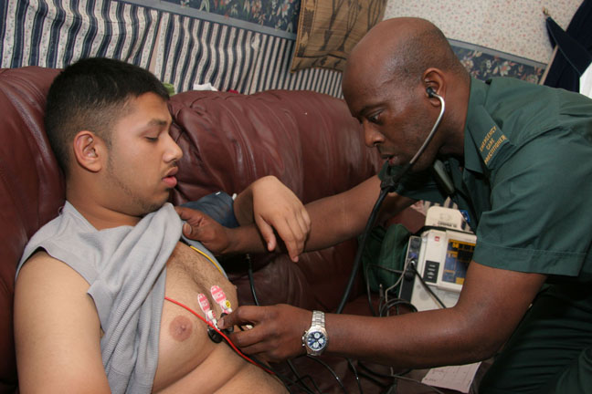
More red flags!
Convey anyone with TLoC and any of the following to the emergency department:
  family history of sudden cardiac death in people aged younger
  than 40 years and/or an inherited cardiac condition
  aged over 65 experiencing TLoC without prodromal symptoms
  new or unexplained breathlessness
  heart failure
  TLoC during exertion
  a heart murmur
Notes:
NOTES FOR PRESENTERS:
Recommendation 1.1.4.2 in full :
Refer urgently for cardiovascular assessment, with the referral reviewed and prioritised by an appropriate specialist within 24 hours, anyone with TLoC who also has any of the following.
An ECG abnormality (see recommendations 1.1.2.2 and 1.1.2.3).
Heart failure (history or physical signs).
TLoC during exertion.
Family history of sudden cardiac death in people aged younger than 40 years and/or an inherited cardiac condition.
New or unexplained breathlessness.
A heart murmur.
Consider referring within 24 hours for cardiovascular assessment, as above, anyone aged older than 65 years who has experienced TLoC without prodromal symptoms.
Additional ambulance service information
NOTE - This is not NICE guidance
When NICE recommend referral to a specialist within 24 hours, this means that the ambulance service should convey the patient to the emergency department and the emergency department will make that referral.

Slide 9

Diagnosing ‘uncomplicated faint’
Diagnosis should be made on the basis of the initial assessment when there are:
no features that suggest an alternative
diagnosis
and
features suggestive of an uncomplicated faint such as the three ‘P’s
  Posture (prolonged standing)
  Provoking factors (such as pain, or a medical procedure)
  Prodromal symptoms (such as sweating or feeling warm/hot before TLoC)
Notes:
NOTES FOR PRESENTERS:
Recommendations in full:
If the person presents to the ambulance service, take them to the Emergency Department unless a diagnosis of an uncomplicated faint or situational syncope is clear. [1.1.4.6]
This slide details how an uncomplicated faint can be diagnosed.
Diagnose uncomplicated faint (uncomplicated vasovagal syncope) on the basis of the initial assessment when:
there are no features that suggest an alternative diagnosis (note that brief seizure activity can occur during uncomplicated faints and is not necessarily diagnostic of epilepsy) and
there are features suggestive of uncomplicated faint (the 3 ‘P’s) such as:
Posture – prolonged standing, or similar episodes that have been prevented by lying down
Provoking factors (such as pain or a medical procedure)
Prodromal symptoms (such as sweating or feeling warm/hot before TLoC). [1.1.4.3]
Additional ambulance service information
NOTE - This is not NICE guidance
Other posture considerations are prolonged sitting
Other provoking factors can be fear and emotional distress
When the recommendation states ‘there are no features that suggest an alternative diagnosis’, this includes the absence of the listed ECG abnormalities.

Slide 10
Diagnosing situational syncope
Diagnosis should be made on the basis of the initial assessment when:
  there are no features from the initial assessment that suggest an alternative diagnosis
  and
  syncope is clearly and consistently provoked by straining during micturition (usually while standing) or by coughing or swallowing
Notes:
NOTES FOR PRESENTERS:
Recommendations in full:
If the person presents to the ambulance service, take them to the Emergency Department unless a diagnosis of an uncomplicated faint or situational syncope is clear. [1.1.4.6]
This slide details how a situational syncope can be diagnosed.
Diagnose situational syncope on the basis of the initial assessment when:
there are no features from the initial assessment that suggest an alternative diagnosis and
syncope is clearly and consistently provoked by straining during micturition (usually while standing) or by coughing or swallowing. [1.1.4.4]
Additional ambulance service information
NOTE - This is not NICE guidance
When the recommendation states ‘there are no features that suggest an alternative diagnosis’, this includes the absence of the listed ECG abnormalities.

Slide 11
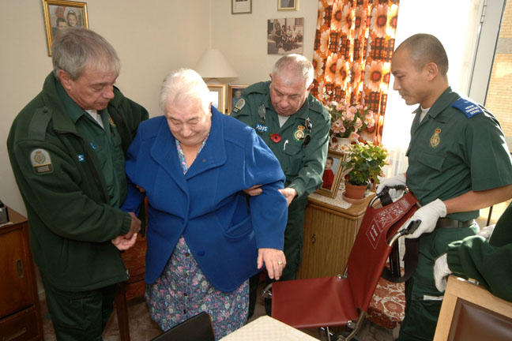
Further assessment required: orthostatic hypotension
If there is nothing that suggests an alternative diagnosis, considering other possible causes of TLoC will help onward treatment of the patient in the emergency department
Consider a diagnosis of orthostatic (postural) hypotension on the basis of the initial assessment when:
there are no features suggesting an alternative diagnosis
and
the history is typical of orthostatic hypotension
If orthostatic hypotension is diagnosed,
consider likely causes, including drug therapy,
and manage appropriately
Notes:
NOTES FOR PRESENTERS:
Additional ambulance service information
NOTE - This is not NICE guidance
If during the initial diagnosis:
the patient has not displayed any red flags (including absence of the listed ECG abnormalities)
there is nothing to raise clinical or social concern
there is nothing that suggests an alternative diagnosis
but a diagnosis of uncomplicated faint or situational syncope cannot be made
the person must still be conveyed to the emergency department for further assessment.
It will help to ensure the patient receives the appropriate treatment as quickly as possible when they arrive at the emergency department if you are able to begin to consider other possible causes such as orthostatic hypertension.
NICE recommendation:
Suspect orthostatic hypotension on the basis of the initial assessment when:
there are no features suggesting an alternative diagnosis and
the history is typical.
If orthostatic hypotension is confirmed, consider likely causes, including drug therapy, and manage appropriately (for example, see ‘Falls: the assessment and prevention of falls in older people’ [NICE clinical guideline 21]). [1.2.1.1]
(Recommendation not in full – see NICE guideline CG109).

Slide 12
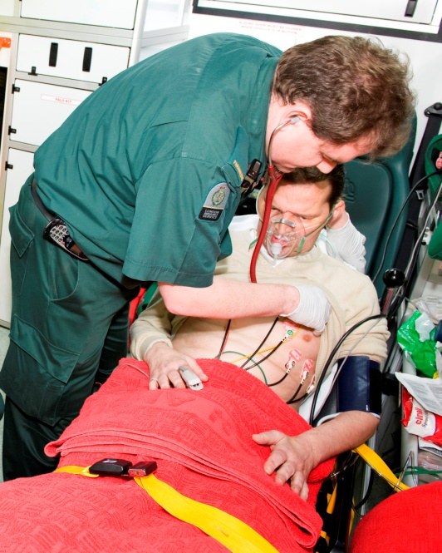
Further assessment required: epilepsy
If there is nothing that suggests an alternative diagnosis, considering other possible causes of TLoC will help onward treatment of the patient in the emergency department
The following signs could indicate epileptic seizures:
  a bitten tongue
  head-turning to one side during TLoC
  no memory of abnormal behaviour witnessed before, during or after TLoC by someone else
  unusual posturing
  prolonged limb-jerking (note that brief
  seizure-like activity can often occur during
  uncomplicated faints)
  confusion following the event
  prodromal déjà vu, or jamais vu
Notes:
NOTES FOR PRESENTERS:
Additional ambulance service information
NOTE - This is not NICE guidance
If during the initial diagnosis:
the patient has not displayed any red flags (including absence of the listed ECG abnormalities)
there is nothing to raise clinical or social concern
there is nothing that suggests an alternative diagnosis
but a diagnosis of uncomplicated faint or situational syncope cannot be made
the person must still be conveyed to the emergency department for further assessment.
It will help to ensure the patient receives the appropriate treatment as quickly as possible when they arrive at the emergency department if you are able to begin to consider other possible causes such as an epileptic seizure (detailed above).
When NICE recommend referral to a specialist within 2 weeks, this means that the ambulance service should convey the patient to the emergency department and the emergency department will make that referral.
NICE recommendation:
Refer people who present with one or more of the following features (that is, features that are strongly suggestive of epileptic seizures) for an assessment by a specialist in epilepsy; the person should be seen by the specialist within 2 weeks (see ‘The epilepsies: the diagnosis and management of the epilepsies in adults and children in primary and secondary care [NICE clinical guideline 20]).
A bitten tongue.
Head-turning to one side during TLoC.
No memory of abnormal behaviour that was witnessed before, during or after TLoC by someone else.
Unusual posturing.
Prolonged limb-jerking (note that brief seizure-like activity can often occur during uncomplicated faints).
Confusion following the event.
Prodromal déjà vu, or jamais vu.
Consider that the episode may not be related to epilepsy if any of the following features are present: Prodromal symptoms that on other occasions have been abolished by sitting or lying down; Sweating before the episode; Prolonged standing that appeared to precipitate the TLoC; Pallor during the episode. [1.2.2.1] (recommendation not in full – see NICE guideline CG109)

Slide 13
Transfer of care to the emergency department
Convey patient to emergency department unless a CLEAR diagnosis of uncomplicated faint or situational syncope is made and there is nothing in the initial assessment to raise clinical or social concern
Give copies of the ECG and the patient report form to the receiving clinician when care is transferred, and to the person who had the TLoC
Don’t forget to acquire a 12-lead ECG in any case of TLoC
Notes:
NOTES FOR PRESENTERS:
Recommendations in full:
If the person presents to the ambulance service, take them to the Emergency Department unless a diagnosis of an uncomplicated faint or situational syncope is clear. [1.1.4.6]
Record carefully the information obtained from all accounts of the TLoC. Include paramedic records with this information. Give copies of the ECG record and the patient report form to the receiving clinician when care is transferred, and to the person who had the TLoC. [1.1.3.1]
Additional ambulance service information
NOTE - This is not NICE guidance
It is acknowledged that if the person is conveyed to the emergency department, it may not be possible to provide them with a copy of the PRF.

Slide 14
Transfer of care to GP and patient
(only when uncomplicated faint or situational syncope diagnosed)
If a diagnosis of uncomplicated faint or situational syncope is made, no further immediate management is required. The crew should:
    reassure the person that their prognosis is good
    advise the person to take copies of their ECG and patient report form to their GP
    explain to the person why their TLoC has possibly occurred and advise them what to do if it happens again
    inform the GP about the diagnosis, directly if possible and tell the GP if an ECG has not been recorded
Notes:
NOTES FOR PRESENTERS:
Recommendations in full:
If a diagnosis of uncomplicated faint or situational syncope is made, and there is nothing in the initial assessment to raise clinical or social concern, no further immediate management is required. If the presentation is not to the GP, the healthcare professional should:
advise the person to take a copy of the patient report form and the ECG record to their GP
inform the GP about the diagnosis, directly if possible; if an ECG has not been recorded, the GP should arrange an ECG (and its interpretation as described in recommendation 1.1.2.3) within 3 days. [1.1.4.5]
For people with an uncomplicated faint (uncomplicated vasovagal syncope) or situational syncope:
explain the mechanisms causing their syncope
advise on possible trigger events, and strategies for avoiding them. If the trigger events are unclear, advise people to keep a record of their symptoms, when they occur and what they were doing at the time, in order to understand what causes them to faint
reassure them that their prognosis is good
advise them to consult their GP if they experience further TLoC, particularly if this differs from their recent episode. [1.5.4.1]
Additional ambulance service information
NOTE - This is not NICE guidance
When diagnosing uncomplicated faint or situational syncope it is important to ensure that none of the listed ECG abnormalities are on the patient’s ECG.

Slide 15

Find out more
Visit www.nice.org.uk/guidance/CG109 for:
  the guideline
  the quick reference guide
  ‘Understanding NICE guidance’
  podcast discussing the implications of the NICE recommendations to ambulance services
  costing statement
  audit support and baseline assessment tool
  guide to resources
  full slide set
Notes:
NOTES FOR PRESENTERS:
You can download the guidance documents from the NICE website.
The NICE guideline – all the recommendations.
A quick reference guide – a summary of the recommendations for healthcare professionals.
‘Understanding NICE guidance’ – information for patients and carers.
The full guideline – all the recommendations, details of how they were developed, and reviews of the evidence they were based on.
NICE has developed tools to help organisations implement this guideline, which can be found on the NICE website.
Podcast - visit http://www.nice.org.uk/newsroom/podcasts/index.jsp or www.nice.org.uk/guidance/CG109 for the link to access a podcast with John Pawelec, paramedic clinical tutor with Yorkshire ambulance service
Costing statement – details of the likely costs and savings when the cost impact of the guideline is not considered to be significant.
Audit support – for monitoring local practice.
Baseline assessment tool - the document can help you identify which areas of practice may need more support, decide on clinical audit topics and prioritise implementation activities.
Guide to resources – to signpost healthcare professionals, patients, families and carers to online resources that will help implement the recommendations in this guideline.
Standard slide set – to help raise awareness of all the key points in the guideline, including the algorithms.

